Slide 1
AI BASED HEALTHCARE MANAGEMENT SYSTEM
[ Presented by ]
S.SRIRAM

Slide 2
Abstract
The project “AI Base Healthcare Management System” has been developed using ASP.Net as front end, and Sql server as backend, which helps to diagnosis diseases and finds relevant hospital with e- appointment system for the users.
Online appointment scheduling processes have essential because of the tendency to generate fragmented time slots.
The proposed website helps the user to effectively search and get appointment from a doctor online with the help of a chatbot system.
The project can effectively reduce hospital searching, schedule problem in health care domain.
In addition, a disease diagnosis has been conducted to identify the disease based on the user profile and their symptoms.

Slide 3
Existing system
The existing system used manual operation, where appointments are handled via phone. Finding appropriate hospital and disease information according to the symptoms is difficult in the existing system.
Identifying the disease and appropriate hospital for the disease is not defined in a single web site. Walk-in appointment where patients are required to fill in registration form .Then patient should wait until patients name is called.
Scheduling an appointment beforehand wherein the patient has to call in ask for any available dates, and wait for the subsequent response from hospital staff.

Slide 4
Proposed System
The proposed system studies about the classic appointment , disease handling, diagnosis and appointment getting problems that every patient/user often encounter in processes in services or healthcare with the help of AI.
• The proposed work brings a new web application with automatic disease diagnosis with hospital suggestion process along with the doctor appointment and a chatbot system.
• The system helps to improve the service of medical field , the user/ patient can find out the disease for their symptoms.

Slide 5
Proposed System
• Initially the system ask the user to register themselves with their basic information’s such as name, gender, date of birth etc., then the user should enter or select their symptoms , after the analysis the system will provide the appropriate hospital and medical service to the patients or users based on the symptoms.
• If the result is not satisfied by the user, then he/she can fix appointment in the nearest hospital /doctors

Slide 6
Advantages
Automated Disease diagnosis
Reduces the time for getting appointments using chatbot.
Helps to find appropriate hospital and doctors.
Enriches the health care services with AI.
Users can easily identify the suitable hospital according their symptoms.
s.

Slide 7
Hardware and Software Requirements
Hardware Requirements Software Requirements
Processor : Intel Duel core Operating System : Windows 10
RAM :4 GB Front End : Asp.net
Hard Disk : 250GB Back End : Sql Server
Printer : HP Ink Jet
Keyboard : Samsung
Mouse : Logi Tech (Optical)

Slide 8
DATA FLOW DIAGRAM
The symbols appearing in the DFD has been explained below:
- Represents a process
- Which shows data flow
- Designation of the data
- Shows Data source
Level-0
User registration /Login
Name, id, password, address, mail
Enter Disease and symptom data set /doctor details
Online diseases analysis system
USER
ADMIN
Enter symptom details /get diagnosis disease and get appointment
View appointment details and user disease details

Slide 9
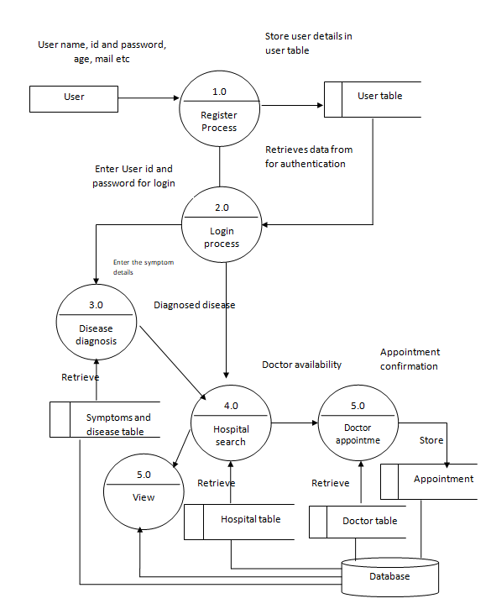
Level-1

Slide 10
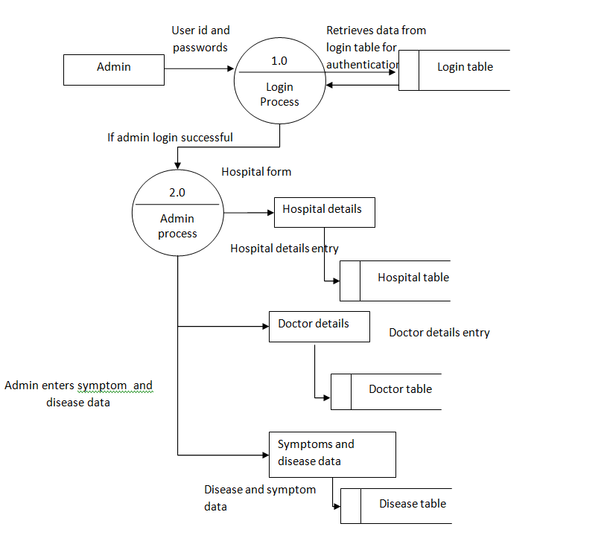
Level -2

Slide 11
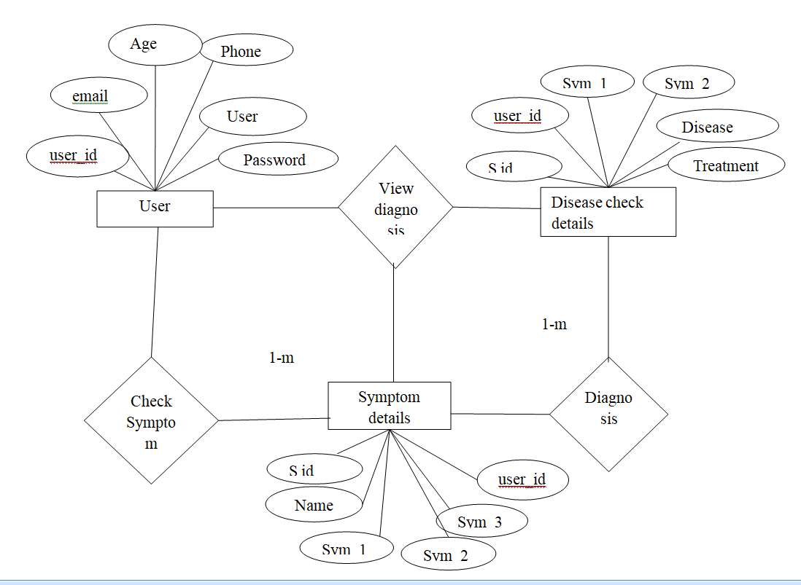

ER-DIAGRAM

Slide 12
Modules
Authentication module
Data set Insertion module
3. Symptoms Checker Module
4. Diagnosis module
5. Hospital details and appointment
6. Report

Slide 13
Authentication module
This module provides security and prevents from unauthorized users. It allows only users with the correct username and password. Thus, it provides authentication.
The system provides user side registration and login process. This maintains the information about the patient such as their ID, name, blood group, gender, age, etc.
Data set Insertion module
The admin will collect the dataset and uploads using the interface. The admin can add dynamic dataset based on the availability. The admin inserts the following data’s,
Symptoms details, disease details such as name of the disease, type of the disease, symptoms of the disease. The admin can able to upload the images related to the symptoms and diseases.
Doctor details
Hospital details

Slide 14
Authentication module
This module provides security and prevents from unauthorized users. It allows only users with the correct username and password. Thus, it provides authentication.
The system provides user side registration and login process. This maintains the information about the patient such as their ID, name, blood group, gender, age, etc.

Slide 15
Data set Insertion module
The admin will collect the dataset and uploads using the interface. The admin can add dynamic dataset based on the availability. The admin inserts the following data’s,
Symptoms details, disease details such as name of the disease, type of the disease, symptoms of the disease. The admin can able to upload the images related to the symptoms and diseases.
Doctor details
Hospital details

Slide 16
Symptoms Checker Module
User should enter or select their symptoms after the analysis the system will provide the appropriate medicines and medical service to the patients or users based on the symptoms In this module the server collect the information of patient like symptoms of a problem in particular portion of a body.
Gathering information and problem of a patient like vomiting and other symptoms.
This maintains the information about the patient such as their address, contact number, height, weight, blood group etc.

Slide 17
Hospital details and appointment
According to the symptoms the server send the specialized hospital according to the reviews and priority the patient can choose the best hospital for their treatment The patient has get the standards and hospitality of the hospital.
Based on the selection, the user can able to get appointment. The appointment can be done via both online and offline.

Slide 18
Report
This module deals with all the reports that can be generated from analyzing the patient’s health condition.
Based on the health condition of the patient, they can undergo treatment from the doctors.
In this final report generation the patient can get detail information about his/her health condition and report generated successfully.

Slide 19
Diagnosis module
In this, server finally identifies the problem and detects the type of disease affected for the particular patient and gives detail report is generated.
In this, server ask for the condition of the patient, if the patient condition leads to sever condition for example if the patient is continuously facing a regular problem like vomiting or anything else, the server can easily identify the patient condition and problem.
The sign and symptoms form contains the information about the patient’s health.
It holds details such as what symptoms and signs there for the patient. It may be normal or it may show some symptom of fever.
Based on the symptom the system will suggest a set of medicines and instructions.
If the user not satisfied with the result he/she can get appointment with the doctor through the website.

Slide 20
CONCLUSION
It is concluded that the application works well and satisfy the needs. The application is tested very well and errors are properly debugged. It also acts as the sharing of files to the valuable resources.
The application was tested very well and the errors were properly debugged. Testing also concluded that the performance of the system is satisfactory.
All the necessary output is generated. This system thus provides an easy way to automate all the functionalities of consumption. If this application is implemented in little consumption, it will be helpful.
Further enhancements can be made to the project, so that the website functions in a very attractive and useful manner than the present one. It is concluded that the application works well and satisfy the needs.
The application is tested very well and errors are properly debugged. It also acts as the sharing of files to the valuable resources.

Slide 21
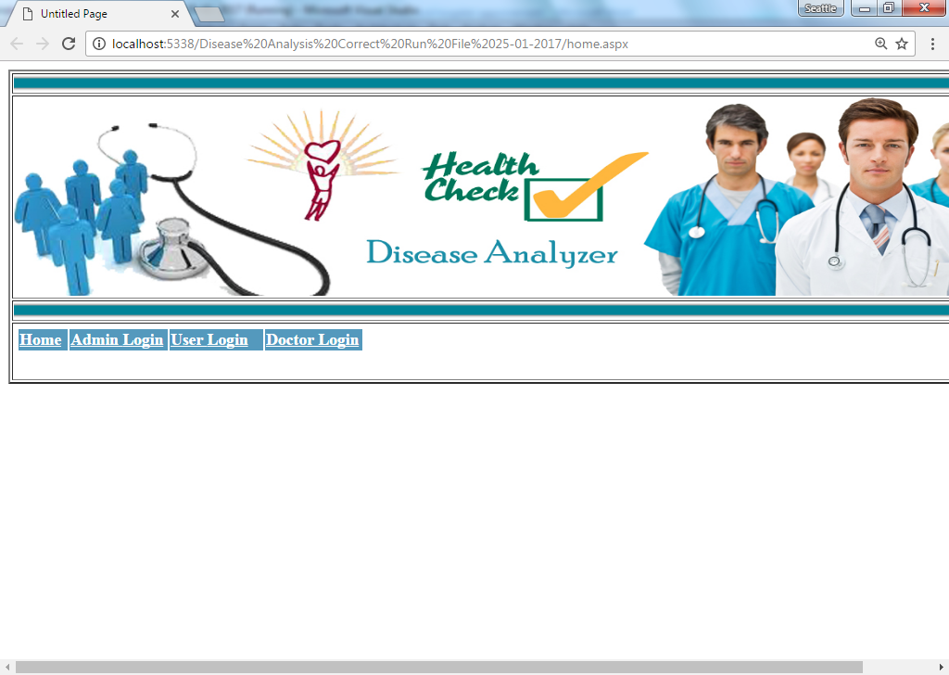
SAMPLE INPUT/OUTPUT REPORTS

Slide 22
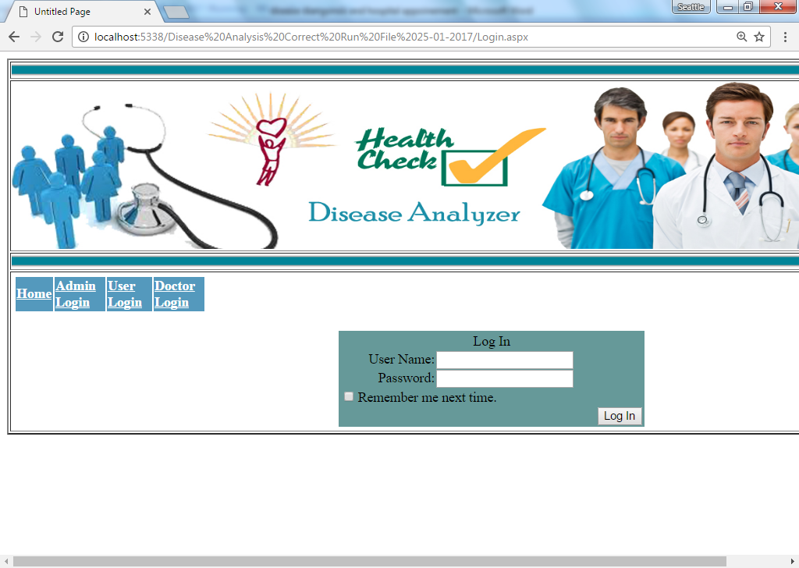

Slide 23
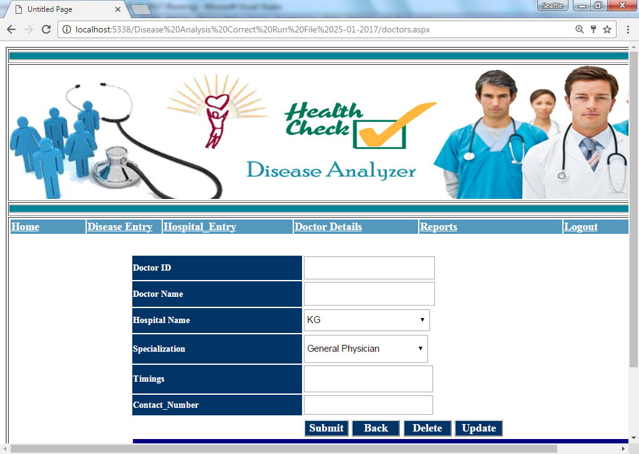

Slide 24
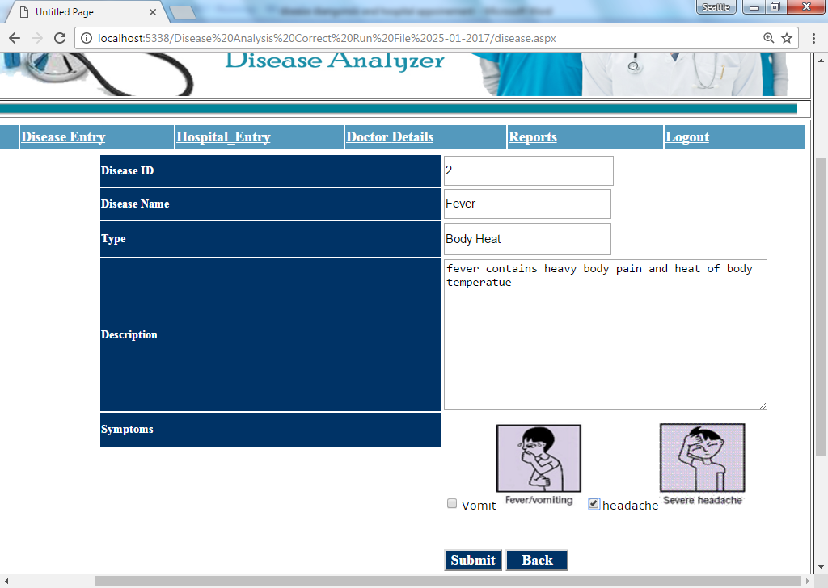

Slide 25
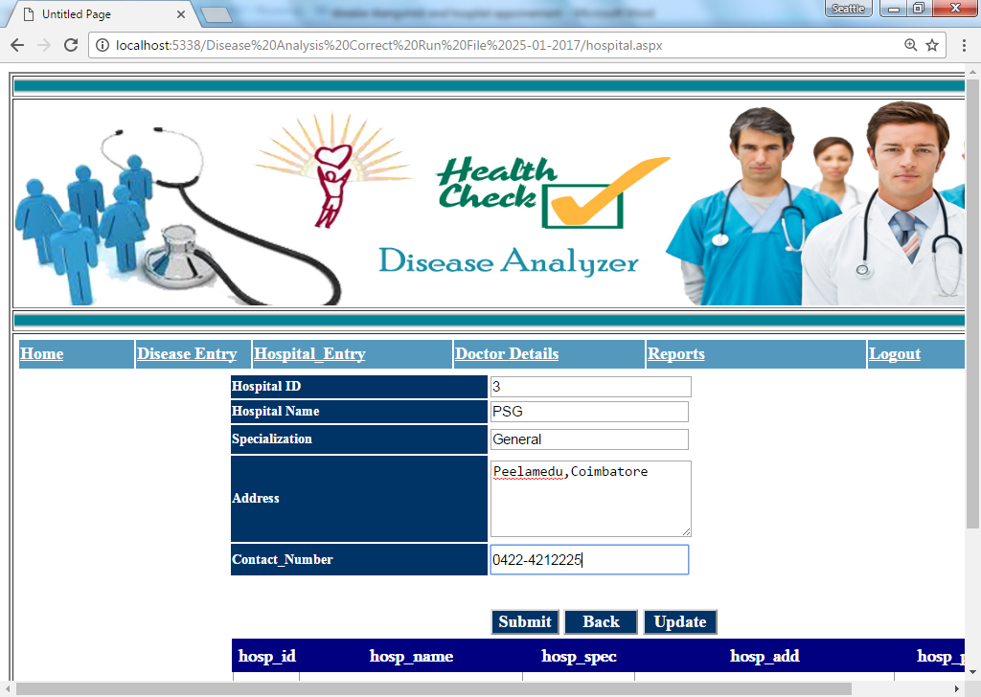

Slide 26
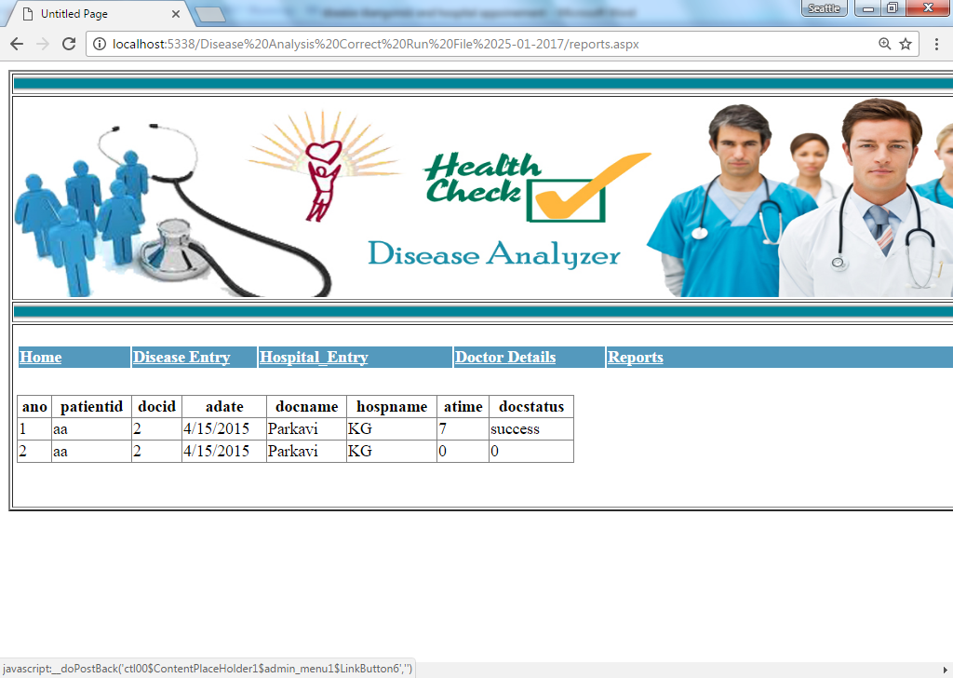

Slide 27
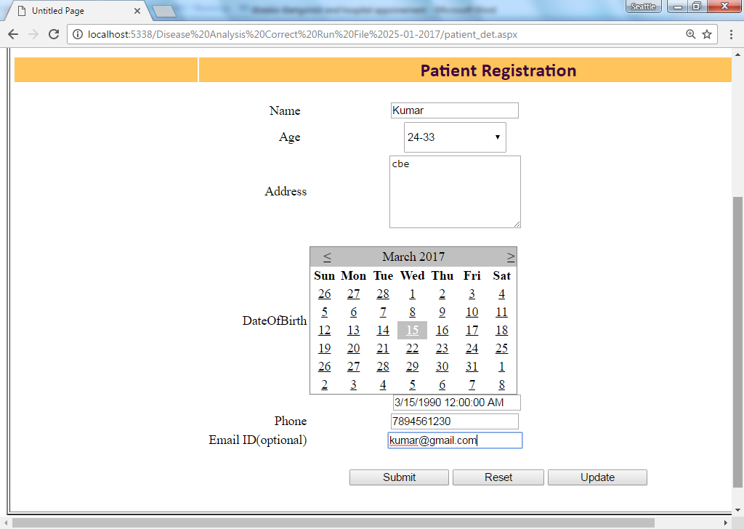

Slide 28
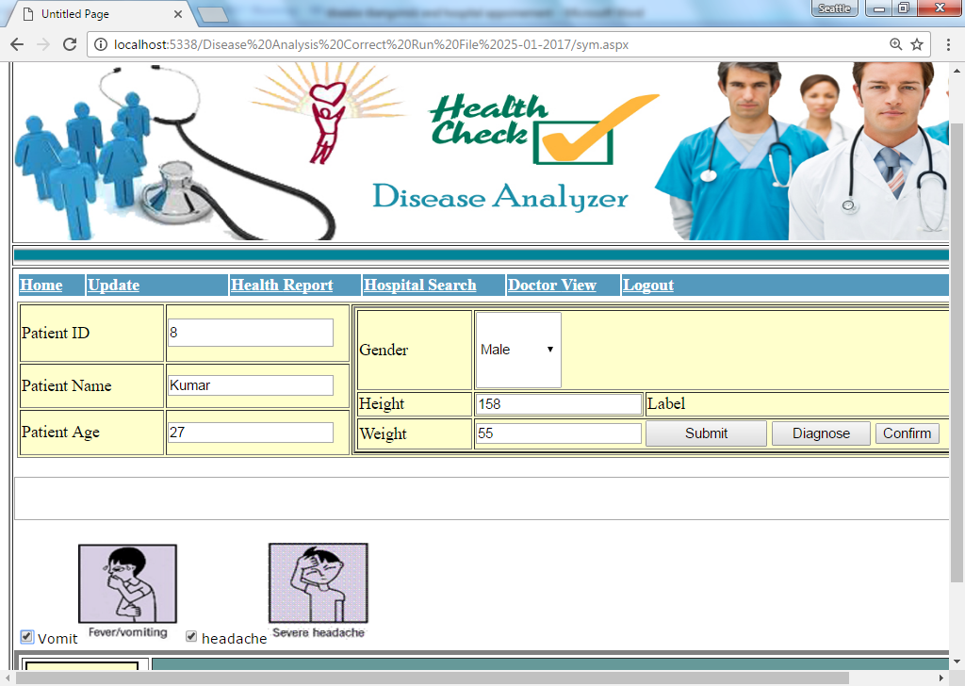

Slide 29
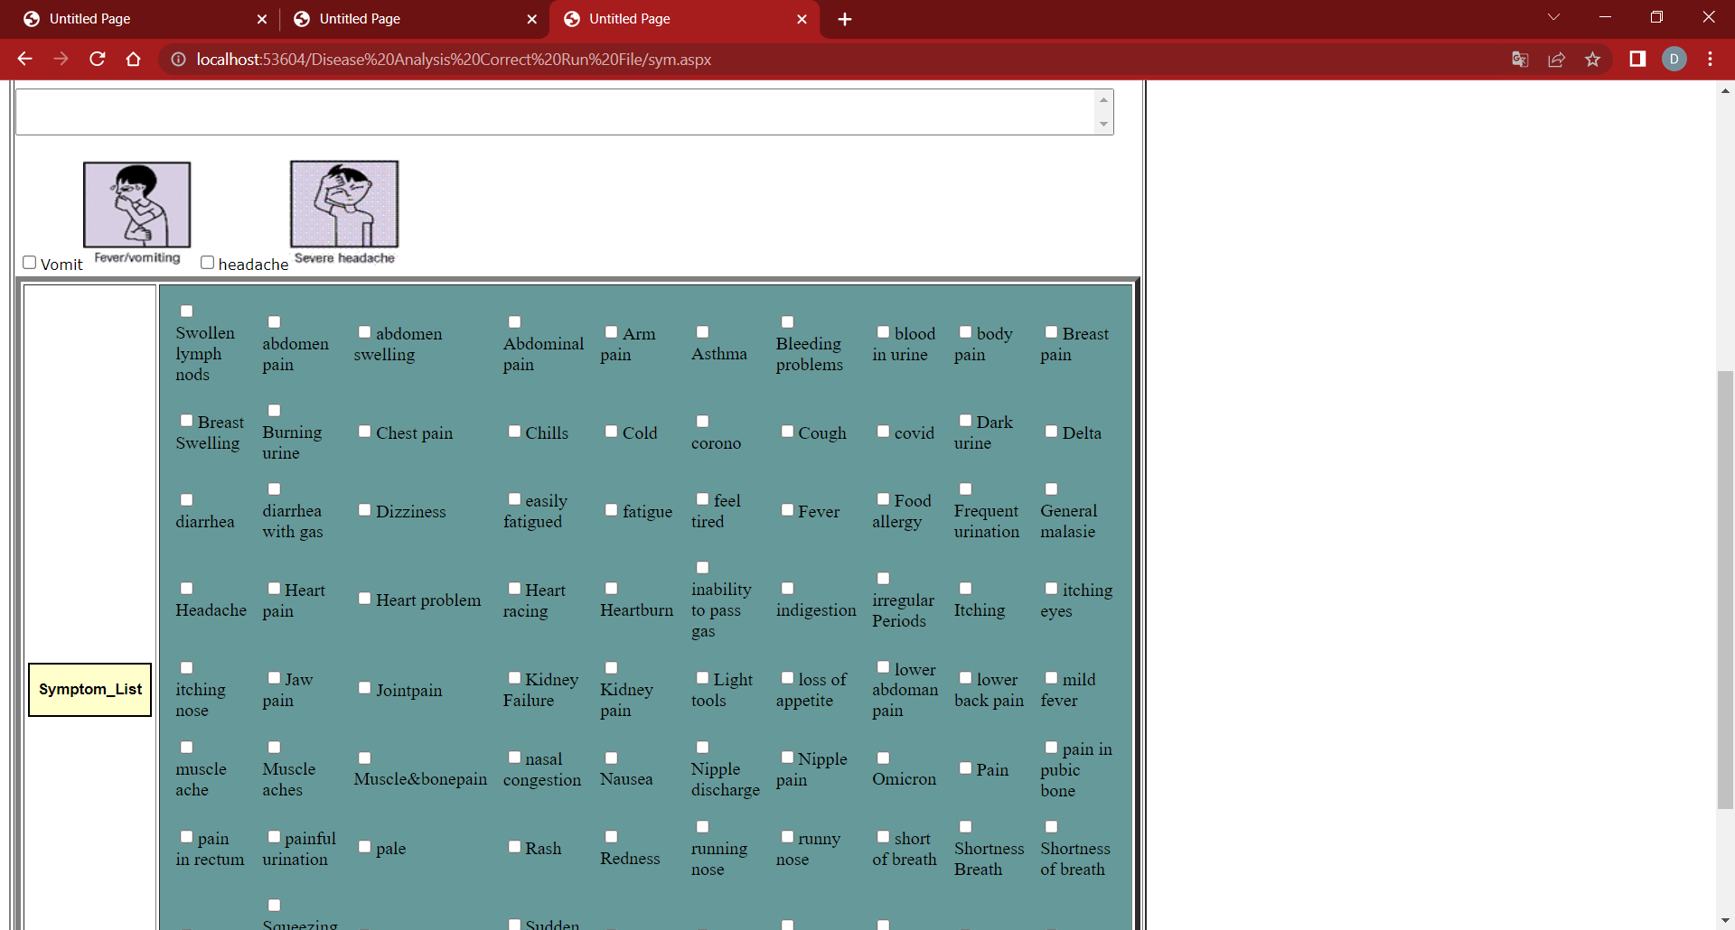

Slide 30
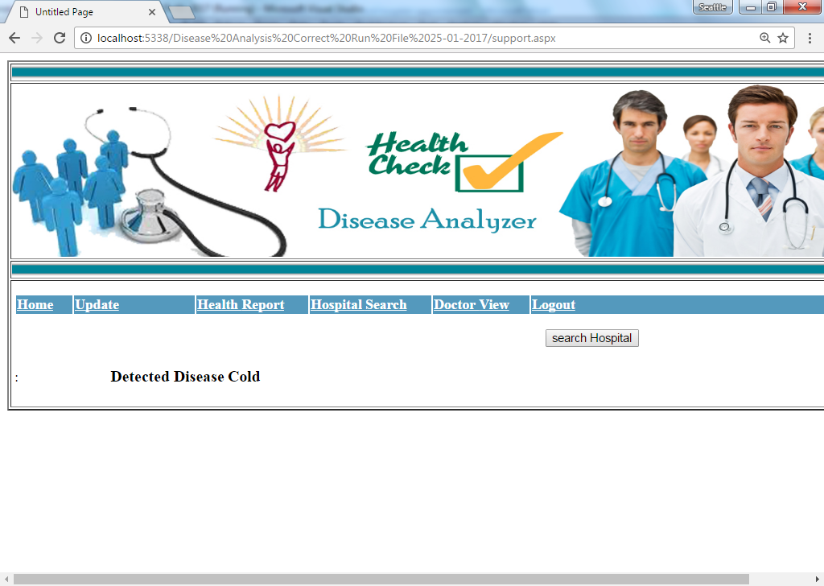

Slide 31
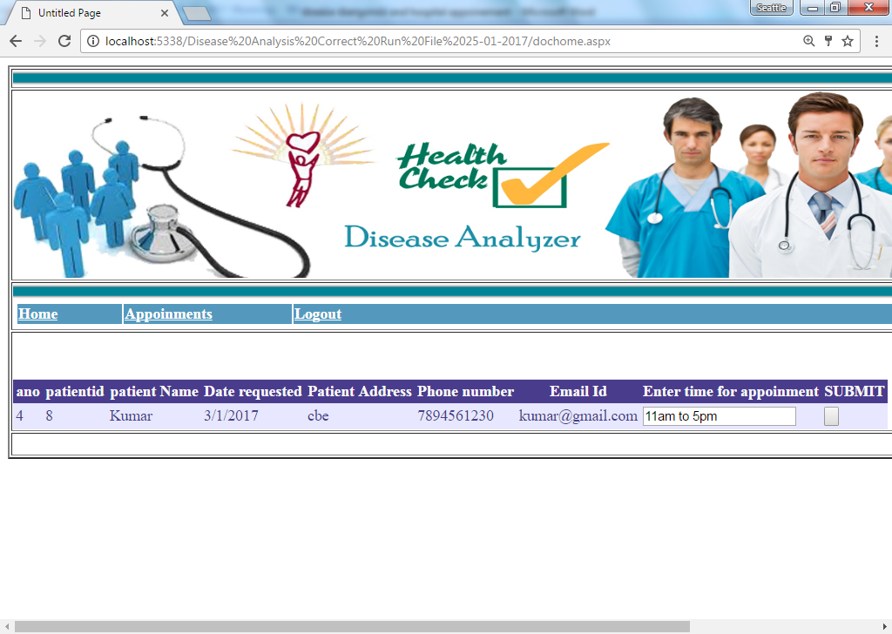

Slide 32
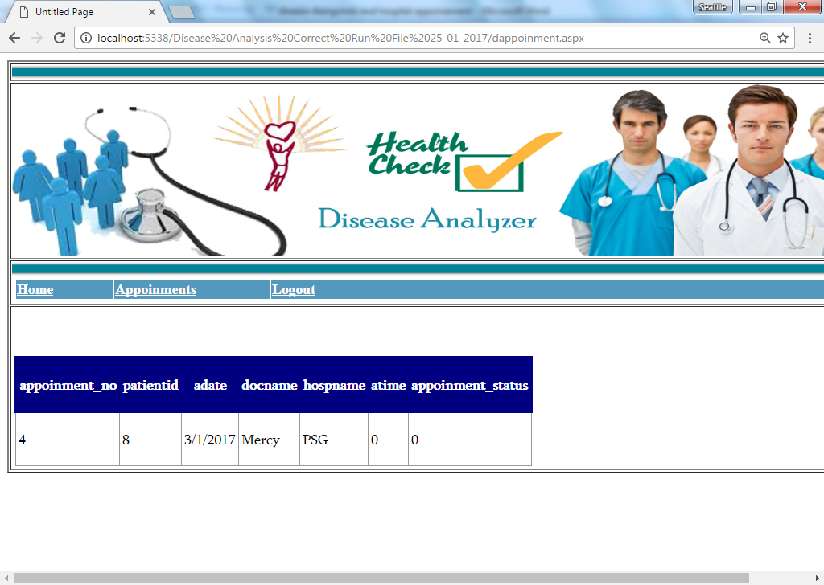

Slide 33
THANK YOU

